Slide 1
Dimensional Model in Erwin II
MIS 634
Business Intelligence & Data Integration - LAB

Slide 2
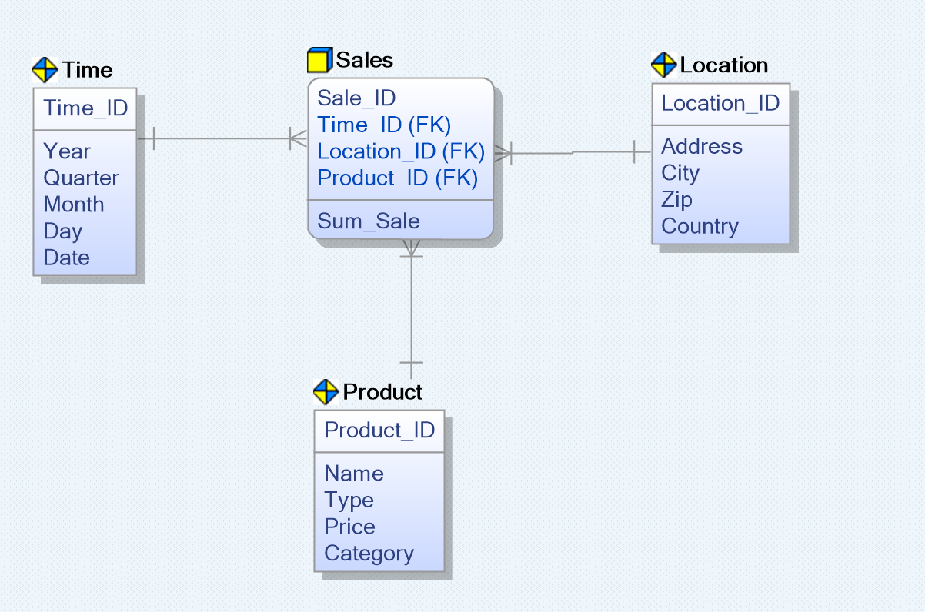

Review: Dimensional Model Diagram
A sample of dimensional model
Facts: numeric values, measurable, quantitative data about a business
Fact Table
It is a “star” schema.
( We will talk about it)
Denormalized
Dimension Tables: descriptive attributes related to fact data

Slide 3
Review: Steps of Dimensional Modelling
Identify Business Process
Identify Grain (level of detail)
Identify Dimensions
Identify Facts
5. Build Schema

Slide 4
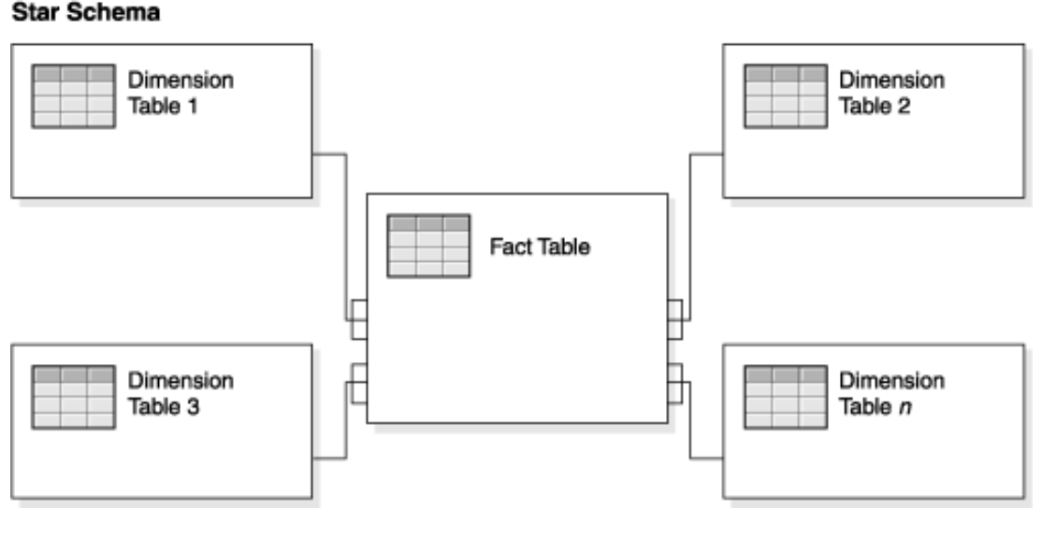
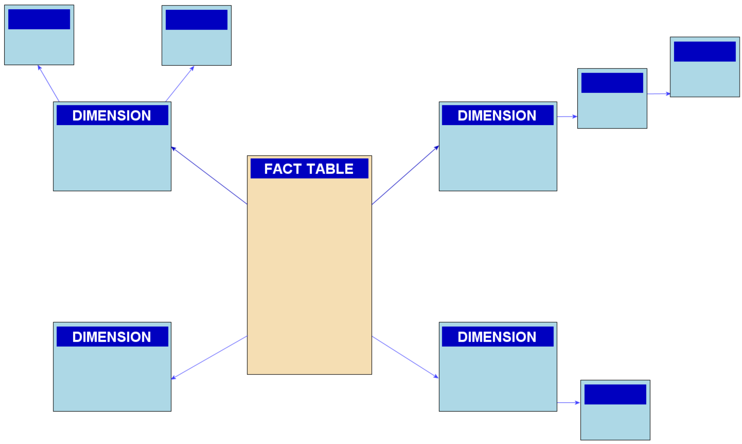
5. Build Schema
Star Schema
Snowflake Schema The snowflake schema is an extension of the star schema. In a snowflake schema. Each dimension table is normalized → dimension table has secondary dimension tables

Slide 5
Bridge Table: Muti-Valued Attribute
Multiple, non-specific number of attributes for a row of a dimension:
Multiple email addresses and phone numbers for a person
Multiple diagnoses for a patients
Multiple credit card numbers for one customer
Define a bridge table to connect multiple instances of the attribute to one row of the dimension
The bridge table captures a many to many relationship

Slide 6
Bridge Table: Multi-Valued Dimensions
Mutiple, non-specific rows of a dimension could participate in a transaction:
Authors of a book or paper
Occupants of a residence
Owners of a home
The dimension table has many to many relations with fact table
A bridge table is defined to group together rows of a dimension that could share a transaction
The bridge table connects a group key to a dimension key
The bridge table could be designed without a primary key
A bridge table with primary key could be defined to be the connector with the fact table, to make the relation with the fact table one to many.

Slide 7
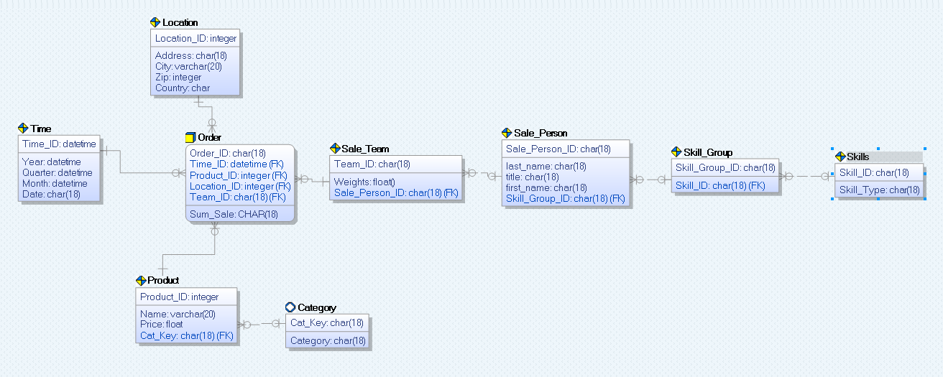
Bridge Table

Slide 8
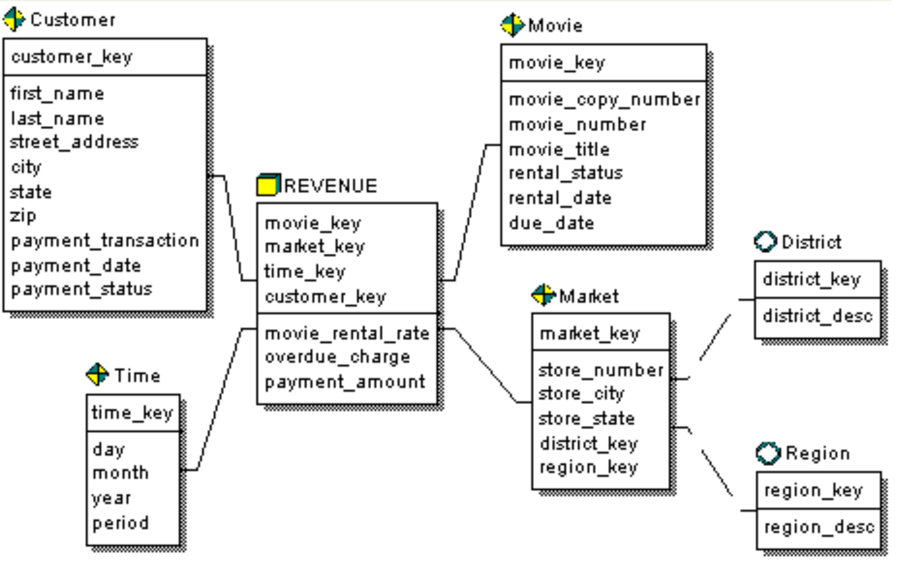
Exercise 1: Star Schema
reference solution: https://bookshelf.erwin.com/bookshelf/public_html/2020R1/Content/User%20Guides/erwin%20Help/Star_Schema_Design.html
secondary dimension tables
outrigger tables

Slide 9
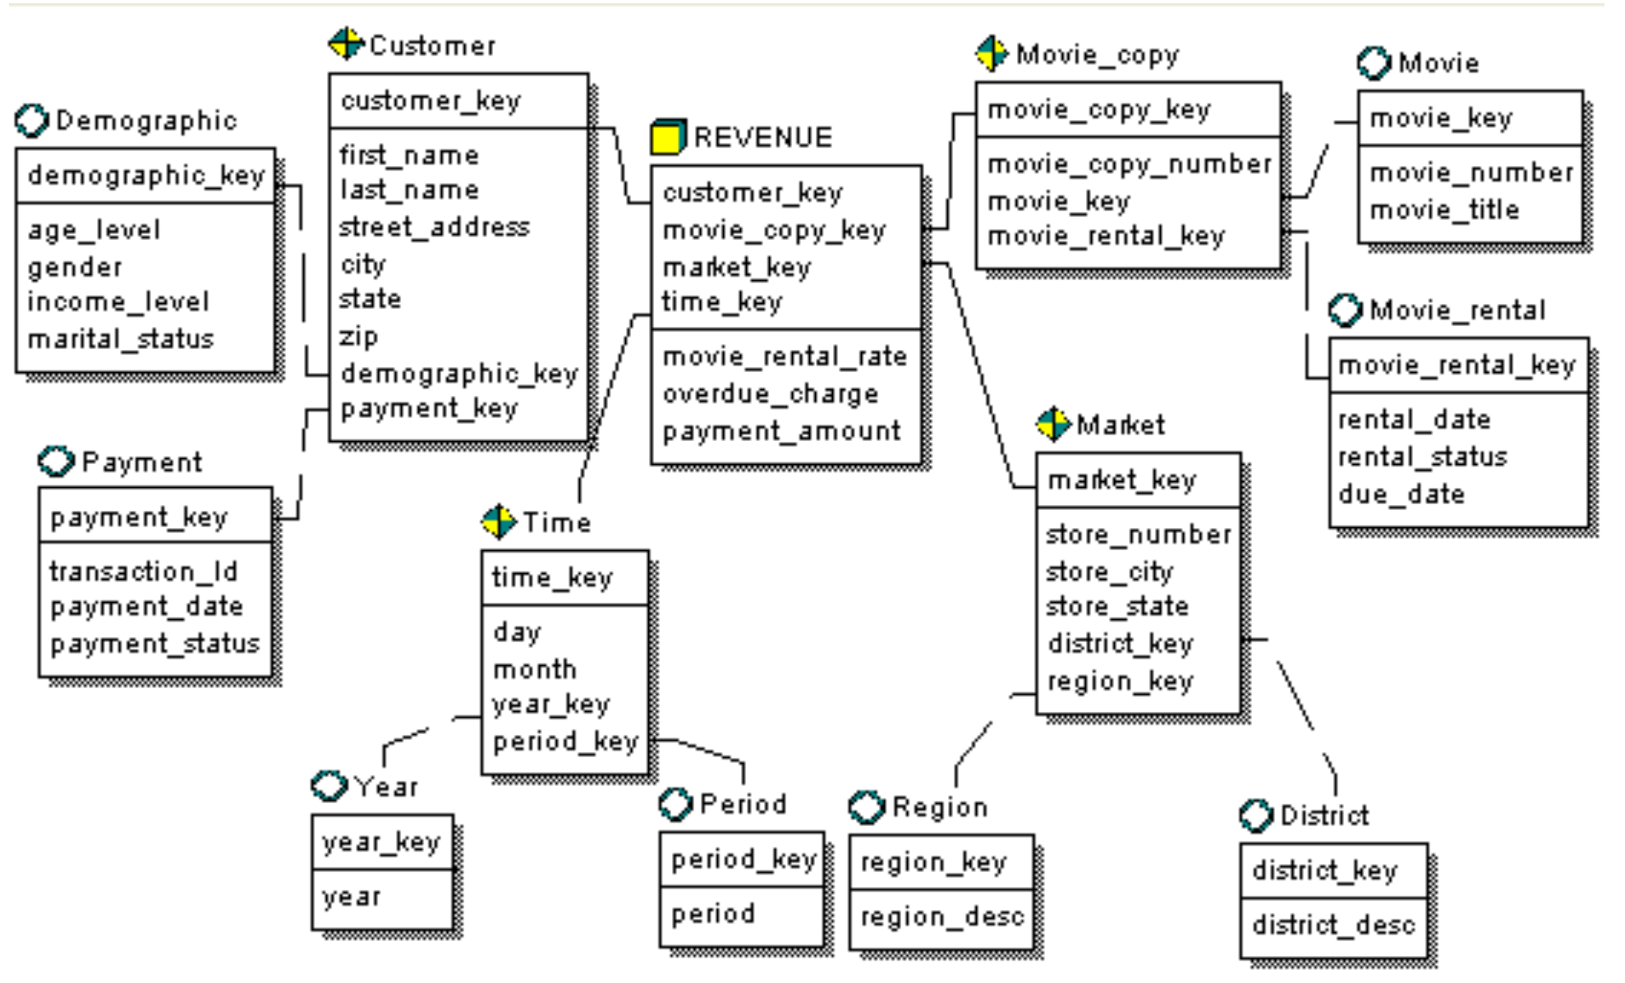
Exercise 2: Snowflake Schema
reference solution: https://bookshelf.erwin.com/bookshelf/public_html/2020R1/Content/User%20Guides/erwin%20Help/Snowflake_Schema.html

Slide 10
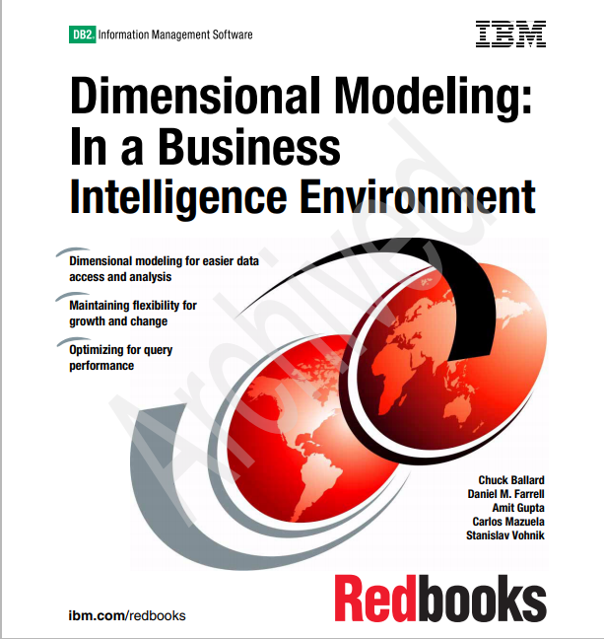
Exercise 3:
Reading:
Dimensional Modeling: In a Business Intelligence Environment
Chapter 7: Case Study: Dimensional model development

Slide 11
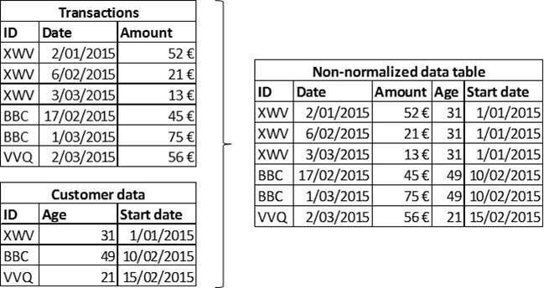
Backup: Normalized V.S. Denormalized

